Slide 1


Spring term 2009
Cortical connectivity and cognition
Functional segregation and integration
Intrinsic and extrinsic connections
Columns and Layers
Feedforward, Feedback and lateral connections
Hierarchies - parallel and serial pathways
Synapses, cells and connections
Convergence and Divergence
Functional roles of forwards and backward connections
Hierarchical perception

Slide 2
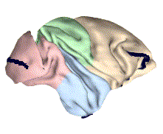
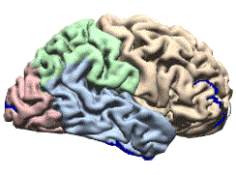
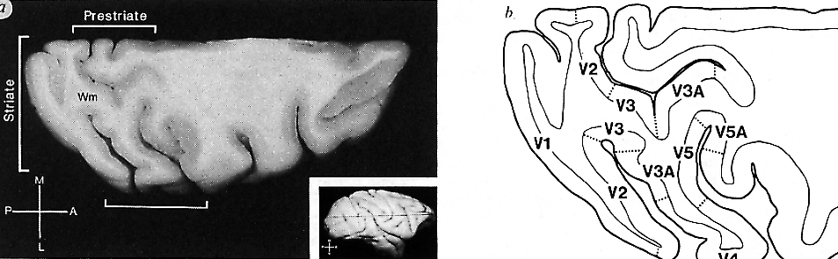
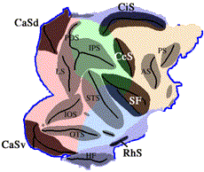
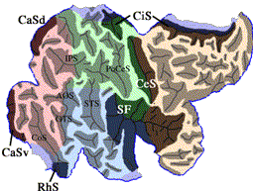
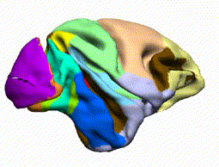
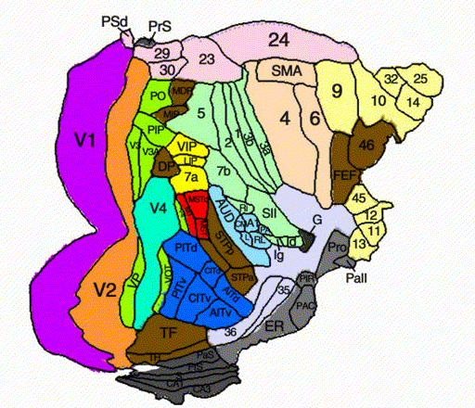
Functional segregation
man
monkey

Slide 3
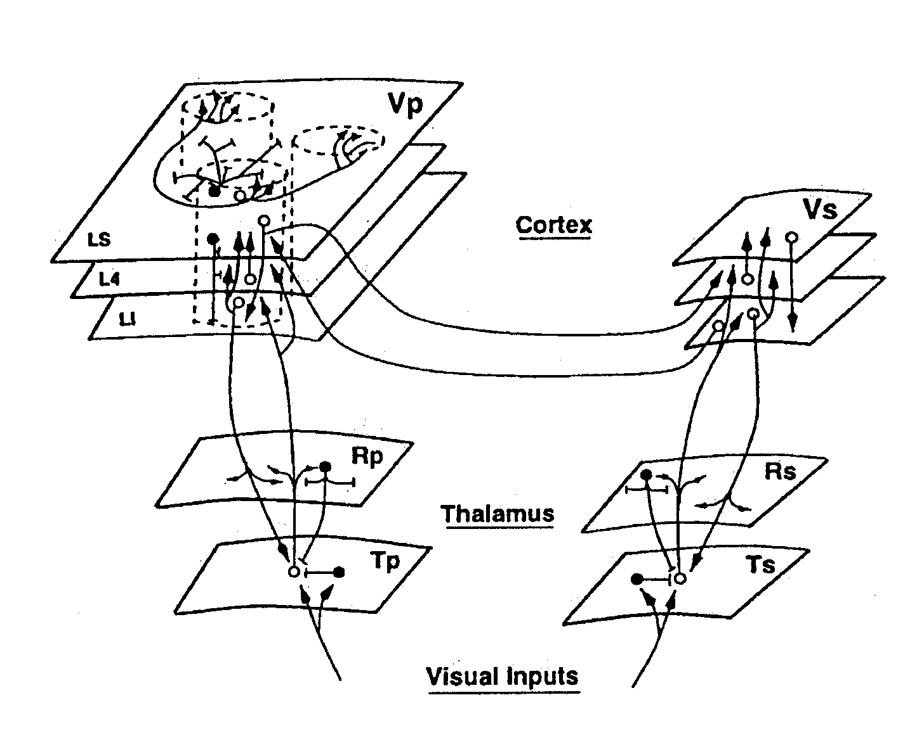
Intrinsic and extrinsic connections (95% of neural tissue)
Intrinsic: Intralaminar (horizontal) connections
Inter-laminar (vertical) connections
Extrinsic: Cortico-cortical
Intra-hemispheric
Inter-hemispheric
Cortico-thalamic
Thalamo-cortical
The Cortico-thalamic unit

Slide 4
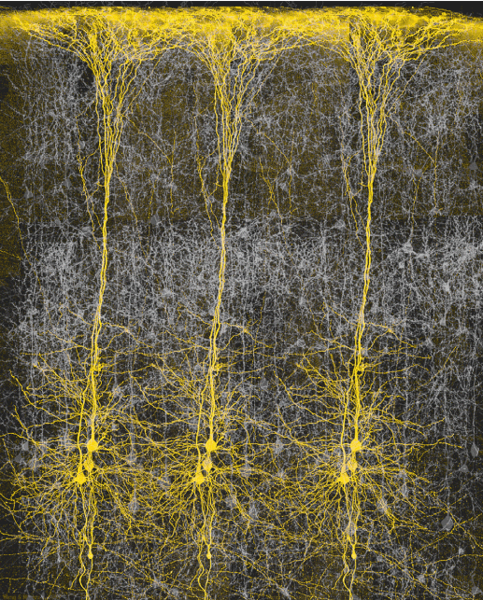
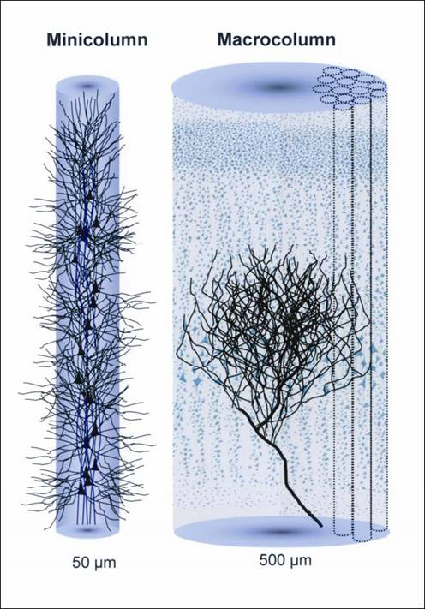
Minicolumns and macrocolumns

Slide 5
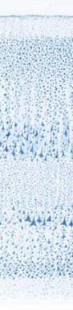
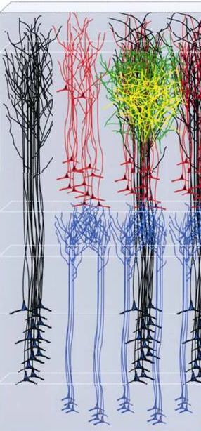



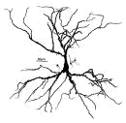

Laminar structure and micro-circuitry
I
II
III
IV
V
VI
Superficial
pyramidal
cells
interneurons
SG
G
IG
spiny stellate
deep pyramidal cells
cortex
Backward connections
thalamus
Forward connections

Slide 6
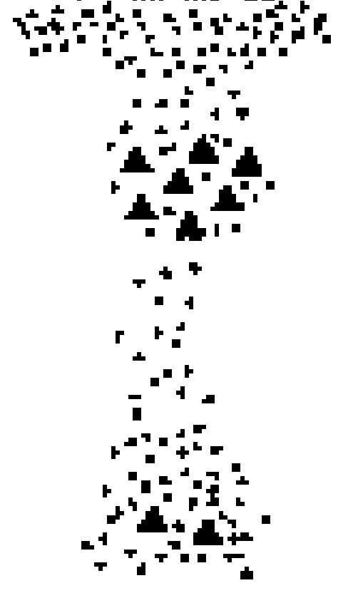
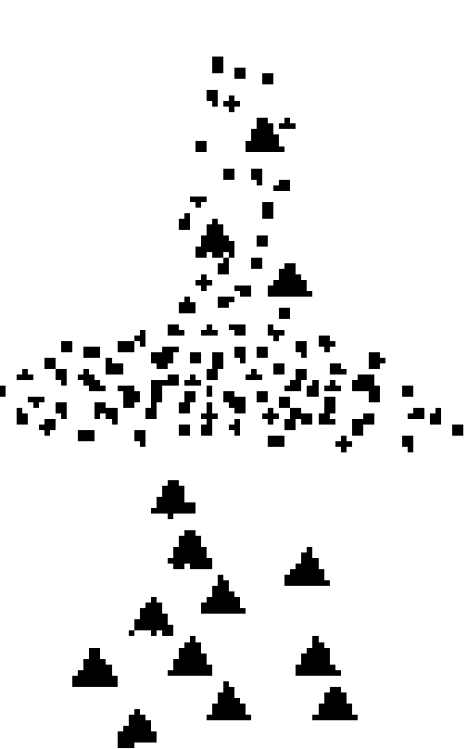
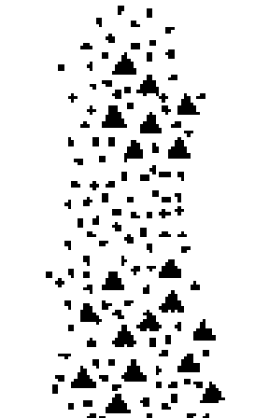
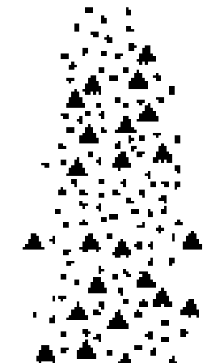
Feedforward, Feedback and lateral connections
Forward: Superficial Pyramidal cells (Supragranular) to granular
Backward: Deep Pyramidal cells (Infragranular) to agranular
Lateral: Bilaminar - Bilaminar
SG
G
IG
more laminar-specific with increasing distance

Slide 7
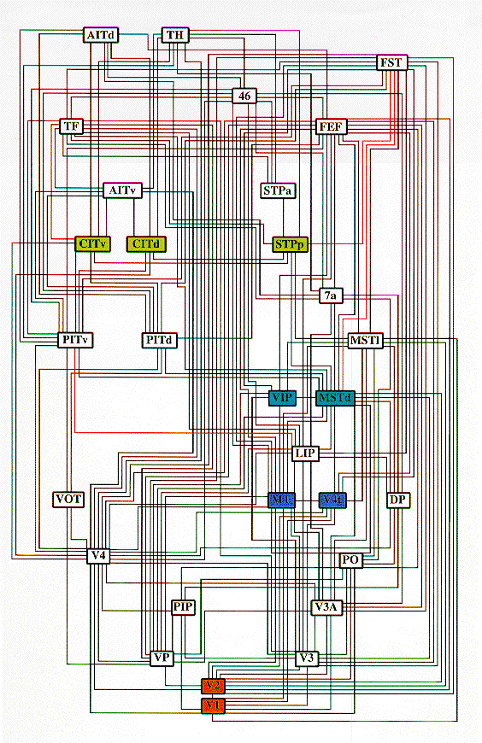
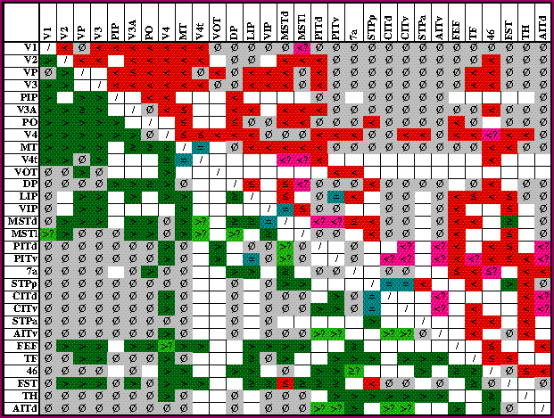
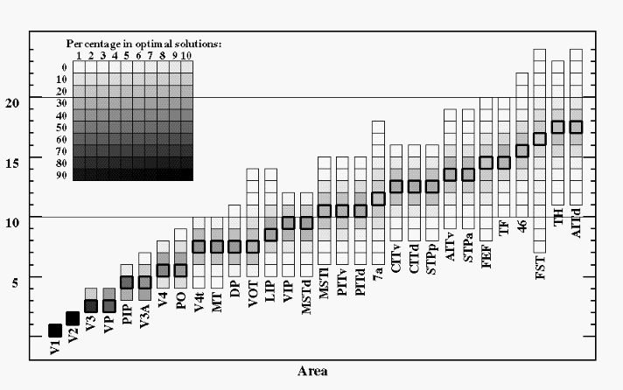
Hierarchies - parallel and serial pathways
Reciprocal connections
Feedback connections (quantitative and qualitative differences)
Pathways (TE and TEO to V1)
Density (e.g. 1:10/20 in the LGN)
Classification of projections and the concept of hierarchical organization
to
from
permutation

Slide 8
dorsal & ventral pathways
and the notion of hierarchies
motor
proprioception
olfaction
visual
auditory

Slide 9
85%
45%
45%
Neuronal density 40,000/mm³
Pyramidal cells 75%
Spiny cells 10%
Smooth cells 15%
Synaptic density 8x10⁸ /mm³
Axonal density 3,200m /mm³
Dendritic density 400m /mm³
Dendritic length density 10mm /cell
Extrinsic excitatory 9000/cell
Intrinsic excitatory 9000/cell
Intrinsic inhibitory 2000/cell
10%
15%
Synapses and cells

Slide 10
Excitatory
Inhibitory
Asymmetric (Type I) Synapses:
Glutamate (ionotropic and metabotropic)
NMDA receptors
Voltage Sensitive
Slow (50ms decay)
Modulatory connections and
nonlinear dynamics
Predominantly in Supragranular layers
(c.f. termination of horizontal and
feedback connections)
Non-NMDA (e.g. AMPA, KA)
AMPA Voltage insensitive
Fast (1.3 - 2.4ms decay)
Driving connections
In vivo: NMDA receptors modulate AMPA gain
[Spiny] Cells:
I Pyramidal Cells:
with apical dendrites
simple and complex receptive fields
II Spiny Stellate Cells:
confined to Layer 4
simple receptive fields
Symmetric (Type II) Synapses:
GABA is the most common
(15% are GABA immunoreactive)
Found on shafts, Soma and initial segment.
GABA_{A} Fast (6ms decay)
GABA_{B} Slow (12-20ms decay)
Involved in the maintenance
of fast oscillatory dynamics
[Smooth] Cells (Interneurons):
I Basket Cells:
17% of all aspiny cells
Horizontal (intralaminar) axons
II Double Bouquet Cells:
Bi-tufted dendritic arbors
Vertical (interlaminar) axons
III Chandelier Cells:
Project to pyramidal cells
Synapses
84% are excitatory
74% are on
Pyramidal cells
Cells

Slide 11
Excitatory connections
Inhibitory connections
Intrinsic:
8mm recurrent collateral axons from spiny cells
Intrinsic axonal patchy terminal arborisations
Primarily in supragranular layers
230-350µm diameter (c.f. pyramidal apical dendrites)
450-700µm apart
Extrinsic:
Target: Excitatory (GLU) cells - 83%
Inhibitory (GABA) cells - 17%
Feedforward: Sparse axonal bifurcation
Topographic
Feedback: Abundant axonal bifurcation
Diffuse
Intrinsic:
1 - 2 mm recurrent collateral axons
Diffuse terminal arborisations
Inter and intralaminar
Extrinsic: None
Intrinsic
Extrinsic

Slide 12
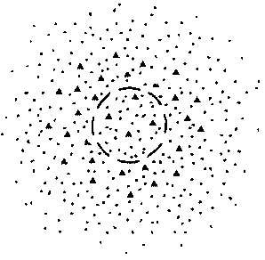
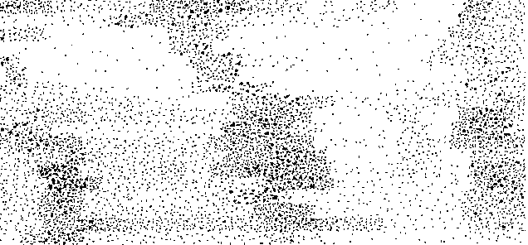
Convergence and Divergence
Cellular: 20,000 synapses per cell
Expected number of synaptic contacts (among cells with overlapping arbors) 1 - 10
Divergence/convergence 10³ - 10⁴
Regional: 5 - 8mm in diameter
Implications for receptive fields
Asymmetric Divergence and Convergence regions
Feedforward - Topographic
Feedback - Diffuse
Cells of origin and termination fields
of connections between V2 and V5
Divergence > Convergence
thick
stripes in V2

Slide 13
Functional roles of Forwards and Backward connections
Reversible Inactivation studies
Functional asymmetries
V1 is necessary for V2 responses
V2 modulates visual evoked responses in V1
Forward connections are Driving
Sparse bifurcation
Patchy axonal terminations
Topographic projections
Mediate effects through fast AMPA and GABA receptors
Promulgation and segregation of sensory information
Backward connections are Modulatory
Frequent bifurcation
Diffuse axonal terminations
Non-topographic projections
Mediate effects through NMDA receptors
Coordination of processing channels
Theoretical accounts
Generative models and prediction

Slide 14



Forward connections provide Feedback
causes (v)
Prediction error
Backward connections embody the Generative model
Prediction

Slide 15
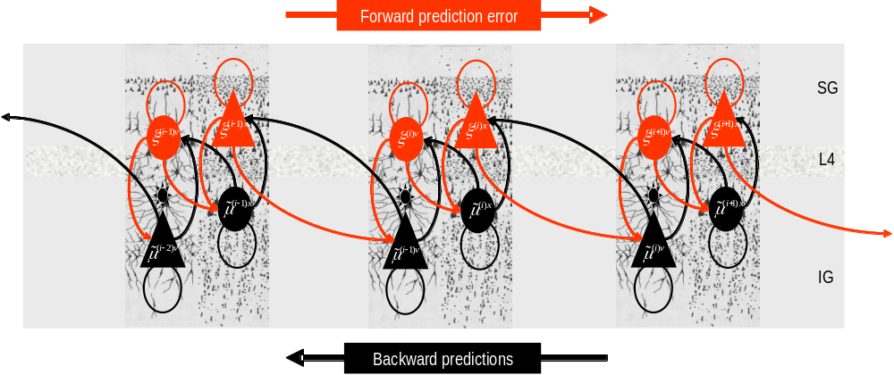
Message passing in neuronal hierarchies

